Slide 1
Shell Bootcamp 2024 3 Reflections for Week #1
Dharya Pratap Singh
Date : 30-Aug-2024

Slide 2

About Me
If you can imagine it, you can achieve it.

Slide 3

My learnings from this week!

Slide 4

Learning 1 | My takeaways
I learnt the importance of communication and teamwork using various activities.
The key takeaways for me was that your line of communication should be open to everyone, and you should be a good team member for the project to succeed.
I can see this implemented as an important part of energy sector because it will be very important to communicate and work together for everyone involved in the organization to find cleaner sources of energy to reach the goal of zero net emissions.

Slide 5
Learning 2 | My takeaways
I learnt about the importance of stakeholder management using various activities.
The key takeaway for me was that it is very important to understand the expectations of the stakeholders from the project and to keep them regularly engaged
I can see this implemented as an important part of energy sector because it will be very important to communicate with all the stakeholders transparently and clearly to make sure everyone is on the same page of reducing carbon emissions while ensuring profitability.
[Add a graphic that provides evidence of what you did to overcome this challenge]

Slide 6
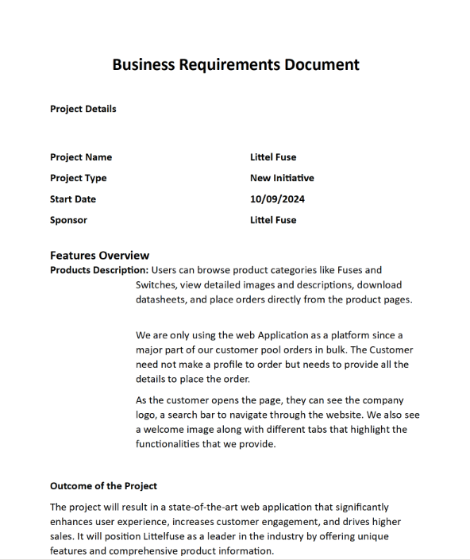
Learning 3 | My takeaways
I learnt about Business Requirement Document (BRD) and Software Requirement Specification (SRS) Document
The key takeaway for me was that it’s very important to know about different stages of software development cycle and to document every stage of the development.
I can see this implemented by the in-house software development teams of the energy sector organizations that will help track each stage of development in detail.

Slide 7

Relevance of learnings for my organization

Slide 8
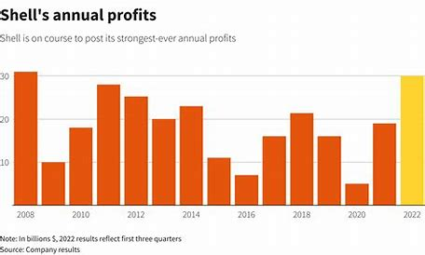
Learning 1 | Relevance for Shell
I feel Shell implements this learning in a very effective manner. The Shell as an organization is very open, and everyone can communicate with every other person which makes it a suitable ground for innovation and progress for the organization
I feel Shell benefits from this learning by attracting and retaining top talents from various domains by providing them a ground to learn, grow and collaborate with others. As a result of which Shell is one of the leaders of its industries, both in advancement of technology and profit.

Slide 9
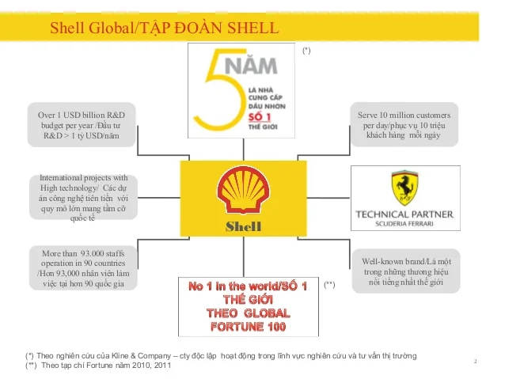
Learning 2 | Relevance for Shell
I feel Shell implements this learning very effective. The Shell as an organization is very transparent with all its stakeholders and make sure all their expectations are being met.
I feel Shell benefits from this learning by keeping all their stakeholders satisfied and by gaining more support from their stakeholders which allows them to grow and keep advancing in their field as an industry leader.

Slide 10
Learning 3 | Relevance for Shell
I feel Shell implements this learning very effectively. The Shell IT business operations teams are very proficient in their job and performs an excellent task of keeping every stage of the development well documented.
I feel Shell benefits from this learning by having detailed knowledge of every stage of the development which allows them to know exactly how much time a project is going to take, which also helps them in planning for the future projects accordingly.
[Add a graphic that provides view of how Shell implements this learning]

Slide 11

Challenges in implementing learning

Slide 12
Challenge faced while implementing Learning 1
The biggest challenge I faced in implementing the learning 1 was coming out of comfort zone. The activities involved for this learning demanded me to come out of comfort zone and to collaborate with other team members and to present our project.
I plan to overcome this challenge by being more involved in group related activities and by giving more presentations.
[Add a graphic that provides evidence of what you did to overcome this challenge]

Slide 13
Challenge faced while implementing Learning 2
The biggest challenge I faced in implementing the learning 2 was taking all the stakeholders expectations into considerations and making sure all their expectations are met simultaneously.
I plan to overcome this challenge by being more understanding of the expectations of the stakeholders and by engaging with them more frequently.
[Add a graphic that provides evidence of what you did to overcome this challenge]

Slide 14
Challenge faced while implementing Learning 3
The biggest challenge I faced in implementing the learning 3 was understanding the business significance of the project. Its easy to understand the technical requirements of an application but it requires additional skills to understand the business significance of the application.
I plan to overcome this challenge by studying real life business significance of existing applications and by improving my managerial side skills.
[Add a graphic that provides evidence of what you did to overcome this challenge]

Slide 15

Action Plan

Slide 16
My Action Plan for this Week
Actions
Timeline
Status
My action plan for this week is to learn the industry relevant applications of every topic that is taught to us and to go and revise these topics at home everyday
The planned timeline to implement the actions in one week
I have successfully learnt the industry relevant applications of the topics that were taught this week

Slide 17

Learning is also Fun!

Slide 18
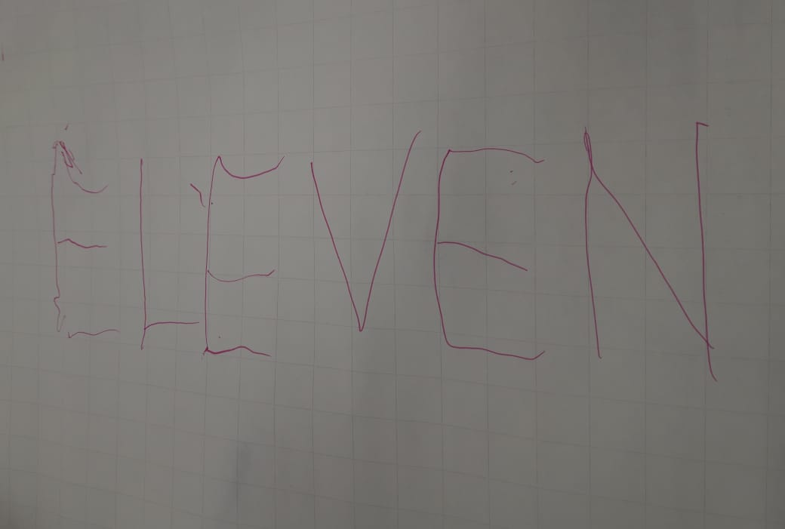
Learning is also Fun!
One of the group activity that was given to us was to write a six or more letters word. The catch was that we need to do this in a group of four where every person will hold the threads that will be attached to the pen. Then all of the four team members need to write the chosen word by coordinating together and the word that we chose was ‘Eleven’
The funny incident which had an element of learning from this week’s topic was this word writing activity only. In this the funny thing was as we started writing the word, the letters were not understandable but as the activity progressed, we were able to improve our performance by improving team coordination.

Slide 19

Summary
The overall week was very informative and interactive. In the first half of the week we learned about the importance of behavioral skills and communication. We also performed various activities that was very fun and collaborative. In the second half of the week we learned about the various stages of the software development cycle. We also learned about different types of software development models and then we studied Agile methodology in detail.
The upcoming week will be very important from the technical side. In the upcoming week we will be learning about the fundamentals and industry relevant information about the DBMS, DevOps and Testing.
The topics of this upcoming week will be in continuation of the technical learning that we did during the second half of this week. Thus, the upcoming week learning will be a smooth transition from the current week learning.

Slide 20
Thank You

